Slide 1

WORKING AT PRIMERA MF BANK
13.03.19

Slide 2

This presentation is by no means exhaustive in its content and coverage
It is to be seen as an informative guide only
www.primeramfbank.com

Slide 3
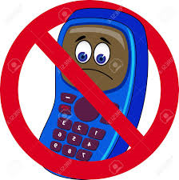

GROUND RULES
Phones on Silent .
Take Important Calls Outside.
Everybody Should Participate.
Quiet people make an effort to speak.
Talkative people give others the opportunity to speak.
Listen Attentively.
www.primeramfbank.com

Slide 4
PRIMERA AFRICA FINANCE GROUP
Primera Africa Finance Group (‘Primera Africa’) is a financial services firm that provides a range of services to clients across Africa. The firm was founded on the 4th of July, 2011.
Our goal is to provide bespoke financial solutions, in the most professional and efficient manner to meet our clients' individual needs and expectations.
We operate in four major business areas:
▪ Securities Trading
▪ Financial Advisory
▪ Principal Investments
▪ Microfinance / Consumer Finance which started operations in February 2014.
All our businesses are supported by the Investment Research Department and other key shared services such as Legal & Compliance, Finance, Operations, Human Resources & Administrative Services, and Information Technology.
www.primeramfbank.com

Slide 5
VISION & MISSION STATEMENT
Our Vision
To be the preferred financial services firm for clients seeking to transact on the African Continent
Our Mission
Creating a strong competitive advantage for the client and the company using our international expertise combined with our local knowledge utilising resilient and flexible integrated business models.
Our Values
Integrity, Teamwork, Accountability,
Innovation & Excellence, Respect
www.primeramfbank.com

Slide 6
ORGANOGRAM ( GROUP)
Board of Directors
Risk Management
Audit
Finance & Investment
Governance
GMD
MD Stockbroking
MD Microfinance
Shared Services
Legal & Compliance
I.C.T
HR
Finance
Internal Control
www.primeramfbank.com

Slide 7
BANK ORGANOGRAM
www.primeramfbank.com

Slide 8
CODE OF CONDUCT
We are a financial services group operating in a regulated industry and staffed by professionals.
We expect all staff to conduct themselves in accordance with SEC, CBN, NDIC and NSE guidelines and professional ethics.
Always act with honesty and integrity. Never use knowledge of Declare any conflicts of interest. Resist being improperly influenced through acceptance of gifts or hospitality.
In addition, staff are expected to demonstrate Primera Africa core values in all their dealings, behaviour, appearance and utterances. information acquired through your role to inappropriately benefit yourself or others.
www.primeramfbank.com

Slide 9
INTERNAL PROCESSES
Where can I find them?
Our SLA’s (Service Level Agreements) - It is important for all staff to know that each unit has its procedural manual which serves as a guide to how a unit operates.
Staff are expected to have this manuals and review them regularly.
www.primeramfbank.com

Slide 10
FRAUD & CORRUPTION POLICY
This policy is established to promote and facilitate consistent organisational behaviour by providing the following guidelines and requires all employees to:
demonstrate the highest standard of personal and corporate ethics.
comply with all internal and external policies, laws and regulations.
value integrity and trust, not merely financial performance, in all dealings with staff, the public and customers.
desire to be open and honest in all internal and external dealings.
Be consistent in the application of policies to all staff whatever their level.
www.primeramfbank.com

Slide 11
FRAUD & CORRUPTION POLICY
Corruption is defined as an act where someone(A) gives (or offers to give) someone in a position of power (B) something to use their power, illegally and/ or unfairly, to the advantage of A (or anyone else). The person offering to give or do something in return for something is always guilty of corruption.
www.primeramfbank.com

Slide 12

ACCEPTANCE OF GIFTS
This Policy regulates and controls the acceptance and receiving of gifts at Primera Mf Bank.
Your working relationships may bring you into contact with organisations where it is normal business practice or social convention to offer hospitality, and sometimes gifts.
Offers of this kind to you can potentially place you in a compromising position by seeking to influence your professional judgement or gain undue favour.
Do not accept any gifts or special considerations.
the advice of your line manager must be sought and the gift should be declared
www.primeramfbank.com

Slide 13

KEY HR POLICIES
Attendance:
Primera Africa values regular and punctual attendance at work . Your line manager and the HR unit should be notified as early as possible if absence from work is anticipated.
If you are unable to attend work due to sickness or injury, your line manager must be notified by telephone before your normal start time or as soon as possible thereafter on the first day of absence, if possible indicating a date of return. Notification should be made by you personally unless impossible due to the nature of the illness where you should arrange for someone else to call on your behalf. During prolonged periods of absence, your manager should be kept informed of progress and an expected date of return.
Dress code:
Look professional at all times.
Telephones& Correspondence
Company telephone/mobile phones or postal facilities must not be used for personal reasons. Company’s computers and systems, including email and access to the internet, must not abused by using these facilities for purposes unrelated to company business.
www.primeramfbank.com

Slide 14
WORKING HOURS
Normal working hours and working pattern will be specified in your Terms and Conditions of Employment.
Lunch or meals policy is that Office employee lunch break will be for a maximum duration of an hour. Staff are required to eat their breakfast and lunch in the office lunch room, Tea and fluids can be taken at staff desk. Staff are required to clear out eating areas after lunch.
Also, in the event that staff eats after the cleaners have closed for the day at 5.00pm; staff are implored to wash up after eating at that time. This is required to keep the kitchenette clean and tidy at all times.
Persistent poor timekeeping means that colleagues are put under pressure to cover your duties. This is not acceptable and will therefore be treated as a potential disciplinary offence under our disciplinary procedures.
www.primeramfbank.com

Slide 15
WORKING HOURS
Dealing with Harassment
www.primeramfbank.com

Slide 16
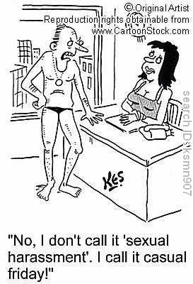
SEXUAL HARASSMENT
Behaviour which has effect of humiliating , intimidating or coercing.
Behaviour that can cause the recipient to be embarrassed, uncomfortable and cause stress.
Any behaviour that is unwelcome, unwanted or unsolicited where the recipient regards it as offensive or undesirable.
Types of Harassment?
Sexual Harassment
Racial
Ethnicity
Age
Disability
Whistle Blower
etc
www.primeramfbank.com

Slide 17
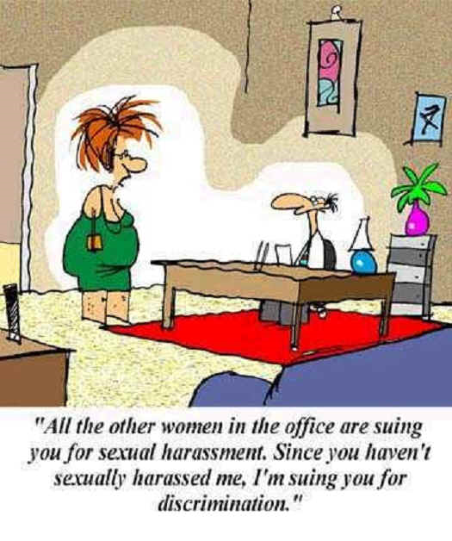
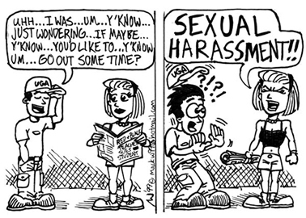
Unwelcome sexual advances, request for sexual favours and other verbal behaviour or physical conduct of sexual nature .
Submission is made implicit condition of an individual employment
Rejection affects employment opportunities
www.primeramfbank.com

Slide 18
WHAT TO DO?
Sexual Harassment will not be tolerated at Primera Africa.
Step 1: Tell the individual that the behaviour is unwelcome and to stop the behaviour NOW!
Step 2: Document the incident if it continues
Step 3: Report the Behaviour to your Supervisor or HR
Step 4: Report Retaliation
www.primeramfbank.com

Slide 19


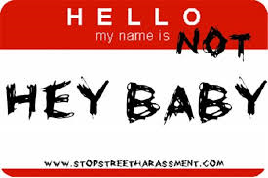
HARASSMENT PREVENTION
Know and Follow the Organisations policy preventing all types of harassment.
Act professionally and treat co-workers with respect.
Report harassing behaviour immediately, even is it is not directed at you.
www.primeramfbank.com

Slide 20
THANK YOU.
QUESTION TIME
www.primeramfbank.com

Slide 21


